Slide 1
MCSD 1043
RESEARCH DESIGN AND ANALYSIS IN DATA SCIENCE
PROJECT PROPOSAL PRESENTATION
TEMPORAL ANALYSIS OF CLIMATIC INFLUENCES ON FOREST FIRE PATTERNS IN PENINSULAR MALAYSIA USING STATISTICAL METHOD
CANDIDATE : GRACE LING KIAN HWAI
LECTURER : ASSOC. PROF. DR MOHD SHAHIZAN BIN OTHMAN
VENUE : DISCUSSION ROOM 4, LEVEL 2, BLOCK N28A
DATE : 25 JULY 2024
FACULTY OF COMPUTING,
UNIVERSITI TEKNOLOGI MALAYSIA

Slide 2

PRESENTATION CONTENTS
TEMPORAL ANALYSIS OF CLIMATIC INFLUENCES ON FOREST FIRE PATTERNS IN PENINSULAR MALAYSIA USING STATISTICAL METHOD
1
RESEARCH INTRODUCTION
2
LITERATURE REVIEW
3
RESEARCH METHODOLOGY
4
INITIAL FINDINGS

Slide 3
RESEARCH INTRODUCTION

Slide 4
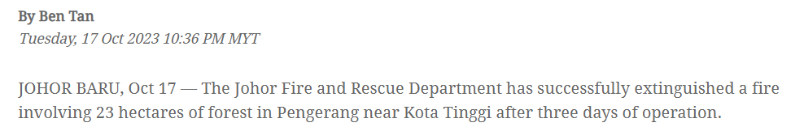
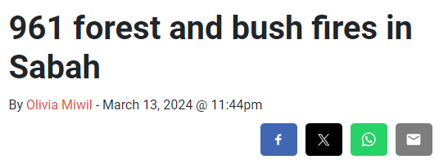
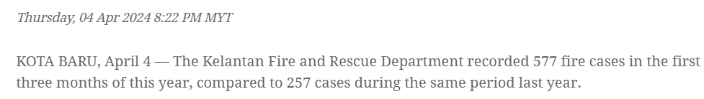
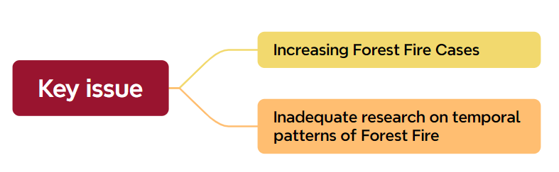
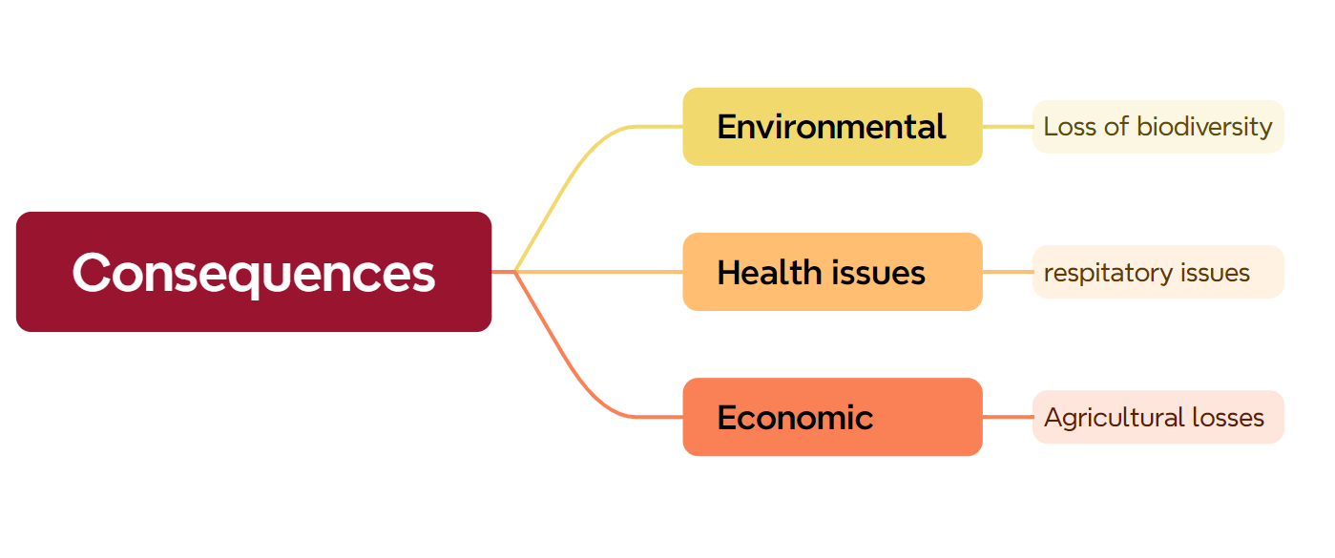
INTRODUCTION
THE NEED OF STUDY
Need for Study!
Urgent requirement for comprehensive data and analysis to improve forest fire management and mitigation strategies.

Slide 5
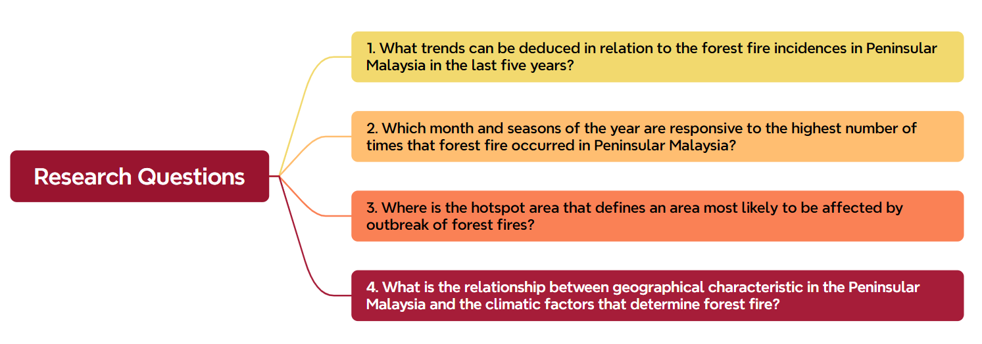
INTRODUCTION
RESEARCH QUESTIONS

Slide 6
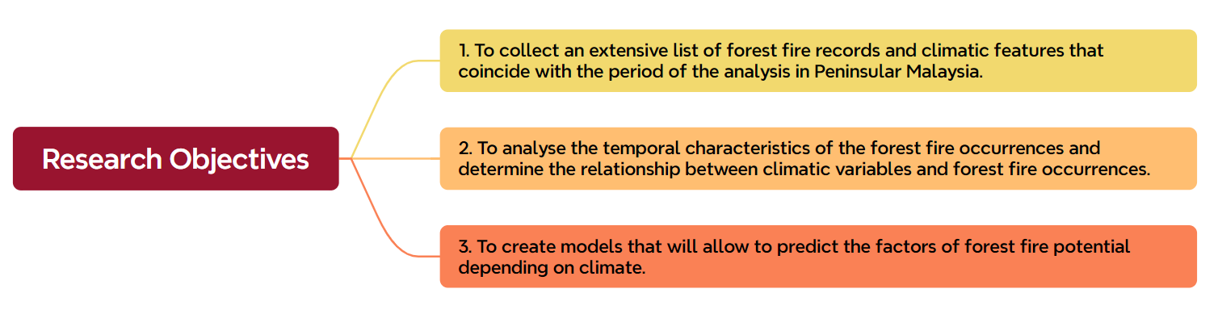
INTRODUCTION
RESEARCH OBJECTIVES

Slide 7
INTRODUCTION
RESEARCH MAPPING
 | Problem Statements | Research Questions | Research Objectives
1 | Lack of understanding of recent trends in forest fire incidences, hindering effective forest fire management strategies. | What trends can be deduced in relation to the forest fire incidences in Peninsular Malaysia in the last five years? | To collect an extensive list of forest fire records and climatic features that coincide with the period of the analysis in Peninsular Malaysia.
2 | Uncertainty about the temporal patterns of forest fire occurrences, making it difficult to allocate resources and implement preventive measures effectively. | - Which month and seasons of the year are responsive to the highest number of times that forest fire occurred in Peninsular Malaysia? - Where is the hotspot area that defines an area most likely to be affected by outbreak of forest fires? | To analyse the temporal characteristics of the forest fire occurrences and determine the relationship between climatic variables and forest fire occurrences.
3 | Lack of detailed knowledge about how geographical and climatic factors interact to influence forest fire occurrences, impeding the development of targeted mitigation strategies. | What is the relationship between geographical characteristics in Peninsular Malaysia and the climatic factors that determine forest fire? | To create models that will allow predicting the factors of forest fire potential depending on climate.

Slide 8
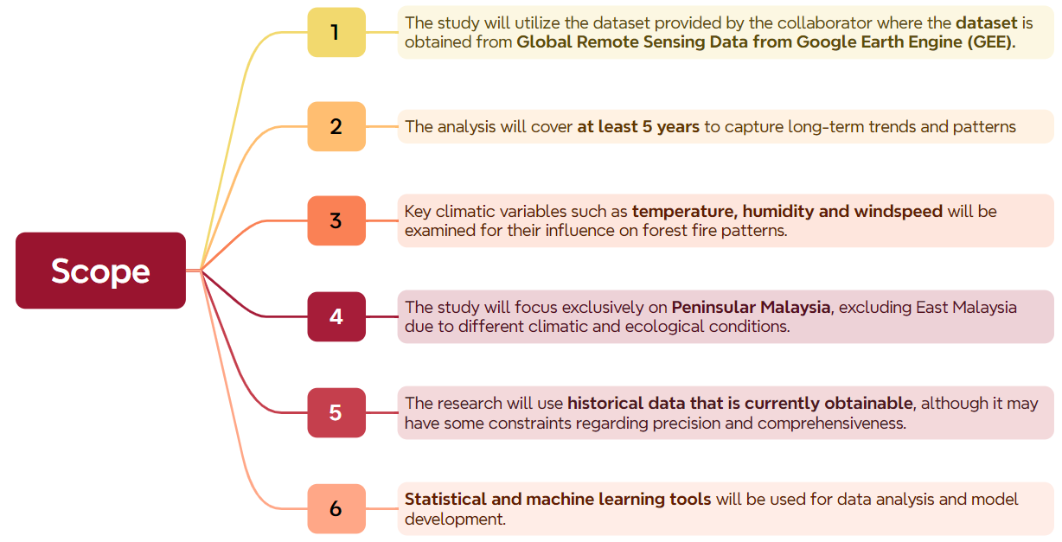
INTRODUCTION
RESEARCH SCOPE

Slide 9
LITERATURE REVIEW

Slide 10
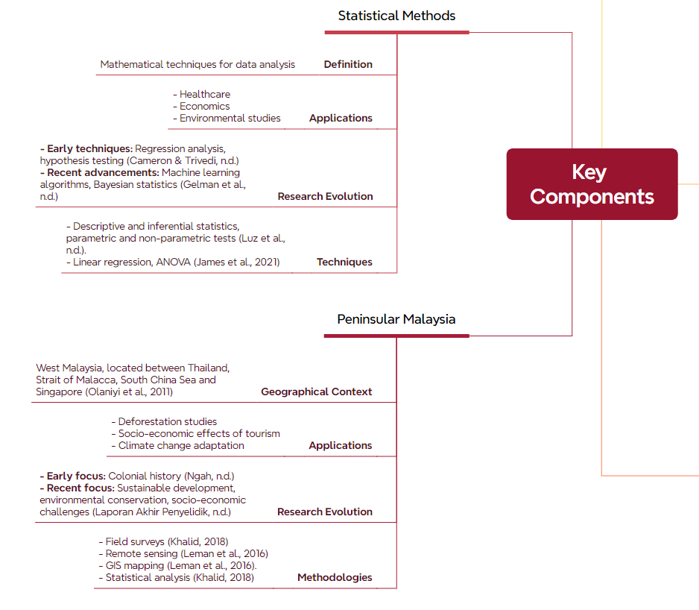
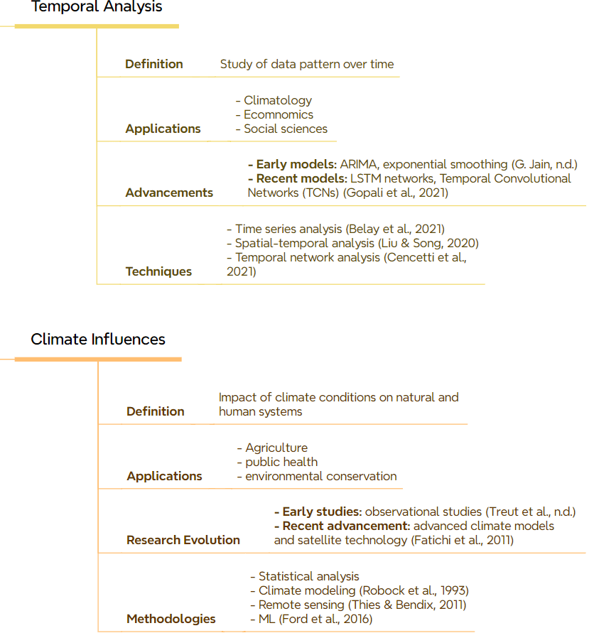
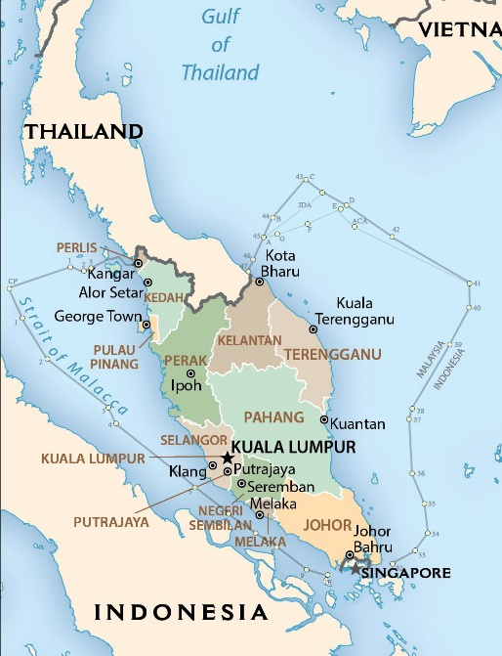
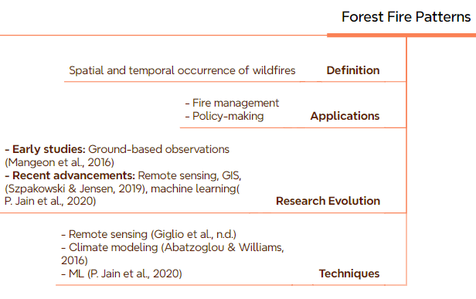
LITERATURE REVIEW
KEY COMPONENTS

Slide 11
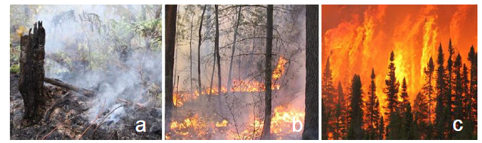
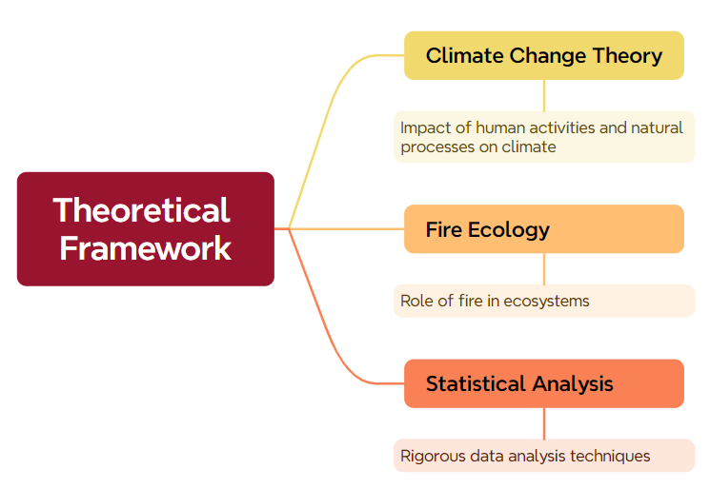
LITERATURE REVIEW
THEORETICAL FRAMEWORK
(Fire Situation in Malaysia, n.d.)
Type of Forest Fire | Causes | Symptoms | Impact
Ground Fire | - Drained peatlands - slash and burn - poor water management | - Slow - patchy burning - underground fires | - Damage to property, vegetation, wildlife - smoke-haze
Surface Fire | - Land clearing - Improper burning techniques - campfires | - Burning of forest floor - spread through secondary forests | - Loss of timber - biodiversity - property damage - health problems
Crown Fire | - High winds - extreme dry conditions - land clearing | - Rapid spread through canopy - high intensity | - Extensive forest damage - disruption of climate - increased emissions
Study | Statistical Method | Climatic Variables | Fire Pattern Identified
Dastour et al. (2024) | Z-score Analysis | Trend component of RobustSTL | Identification of anomalous periods in time series data
 | Mann-Kendall (MK) Test | Relative Humidity, Precipitation, Air Temperature (Min & Max) | Detection of trends in climatic variables and fire occurrences
 | Sen’s Slope Estimator (SSE) | Relative Humidity, Precipitation, Air Temperature (Min & Max) | Evaluation of the magnitude and direction of trends
Halofsky et al. (2020) | Statistical Model | Temperature, Precipitation, Global Climate Models | Future projections of area burned; Increased area burned with warming climate
P. Jain et al. (2020) | Self-Organizing Maps (SOMs) | Temperature, Humidity, Rainfall | Correlation between fire weather and large-scale climatic patterns
 | Linear Regression (LR) | Temperature, Rainfall | Predicting fire danger indices based on weather observations​
 | Random Forest (RF) | Various climatic variables | Superior performance in fire severity mapping and fire detection
Szpakowski & Jensen (2019) | Point-wise meteorological data-based operating systems (WFAS, FWI, FFDRS, Nesterov Index) | - Temperature - Humidity​ - Precipitation - Wind speed​ | - Fire hazard mapping based on environmental factors like fuel conditions and topography - Dynamic variables like fuel moisture and vegetation conditions for short-term fire risk mapping
 | Remote sensing and GIS techniques ​

Slide 12
LITERATURE REVIEW
RESEARCH GAP
Aspect | Previous Studies | Current Research | Research Gap
Data Sources | Satellite imagery, weather stations, historical records | Combination of satellite imagery, climate models, and field data | Integration of multiple data sources for comprehensive analysis
Methodology | Regression analysis, predictive modelling, remote sensing | Advanced statistical methods | Application of machine learning for improved prediction accuracy
Focus Area | General climatic influences on fires | Specific focus on Peninsular Malaysia | Lack of region-specific studies addressing local climatic conditions
Policy Recommendations | General fire management strategies | Tailored recommendations for Peninsular Malaysia | Need for localized strategies based on detailed analysis
Giglio et al. (2020)

Slide 13
RESEARCH METHODOLOGY

Slide 14
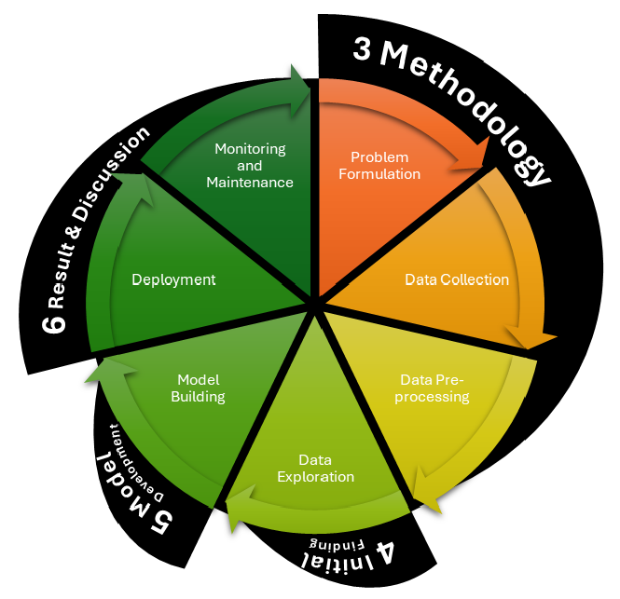
RESEARCH METHODOLOGY
DATA SCIENCE PROJECT LIFE CYCLE

Slide 15
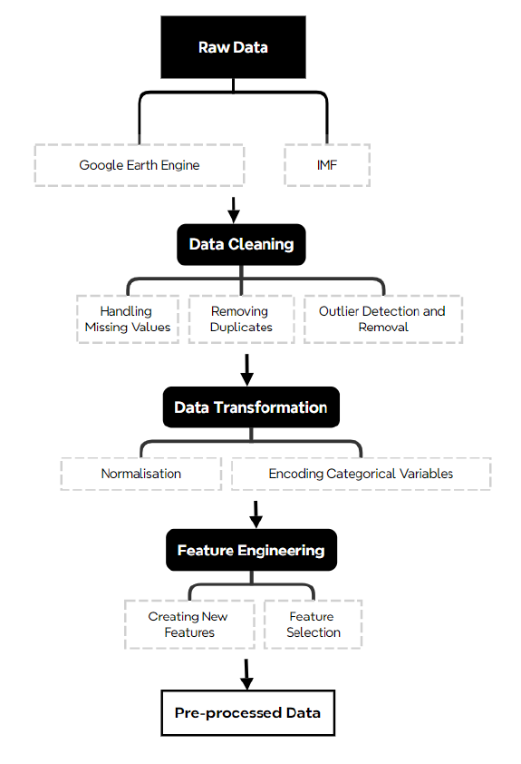
RESEARCH METHODOLOGY
DATA SOURCE, DATA COLLECTION, DATA PREPROCESSING
Remote sensing data for forest fires.
Comprehensive climate variables such as temperature, precipitation, and humidity.

Slide 16
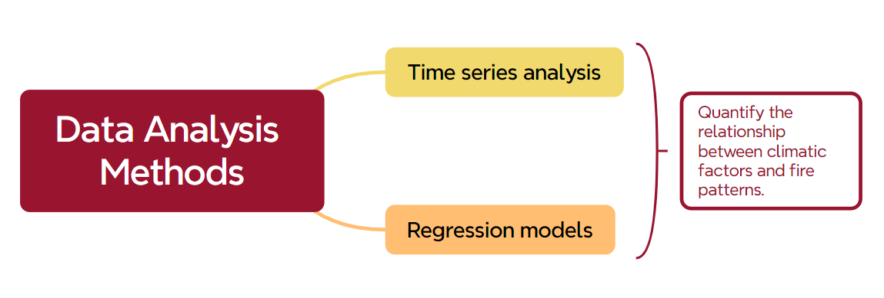
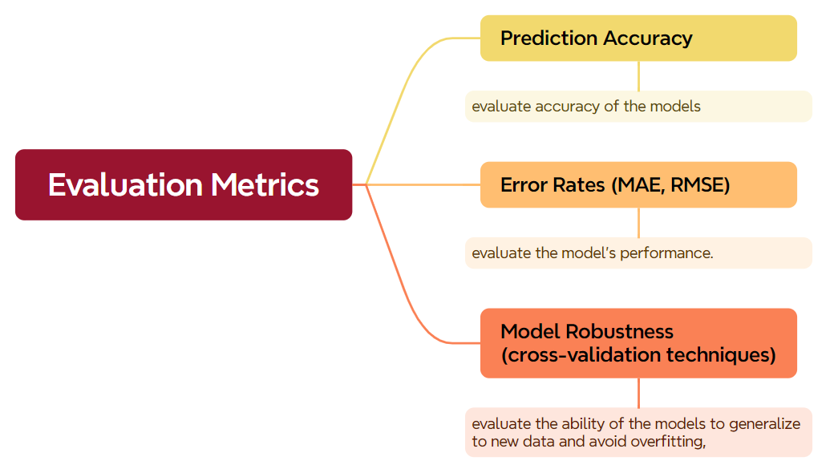
RESEARCH METHODOLOGY
DATA ANALYSIS AND EVALUATION METRICS

Slide 17
RESEARCH METHODOLOGY
COMPARISON OF METHODS
Aspect | Previous Studies | Current Research | Research Gap
Data Collection | Satellite imagery, weather stations | Google Earth Engine, IMF Climate Change Dashboard | Need for high-resolution temporal data
Methodology | Statistical analysis, machine learning | Advanced statistical methods | Integration of advanced AI techniques
Geographic Focus | Southeast Asia | Peninsular Malaysia | Need for region-specific studies
Validation | Separate dataset | Cross-validation with real-time data | Implementation of real-time validation techniques
Applications | Fire detection, prediction | Fire detection, prediction, management | Development of comprehensive fire management systems
Sabani et al. (2009); Saruni Dwiasnati & Yudo Devianto (2021); Ghali and Akhloufi (2023); Sudiana et al. (2023); Meng et al. (2024)

Slide 18
INITIAL FINDINGS

Slide 19
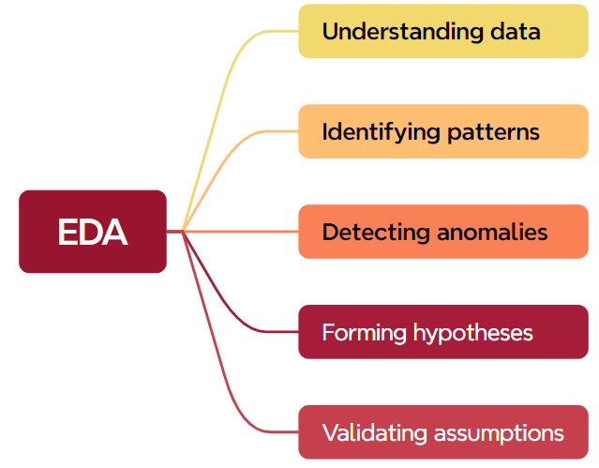
INITIAL FINDINGS
Exploratory Data Analysis (EDA)

Slide 20
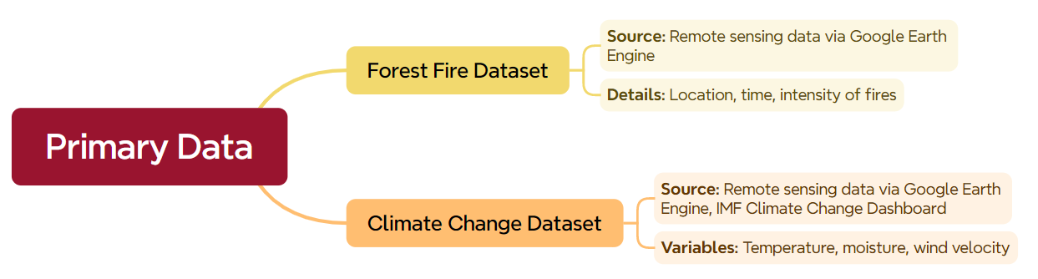
INITIAL FINDINGS
DATASETS

Slide 21
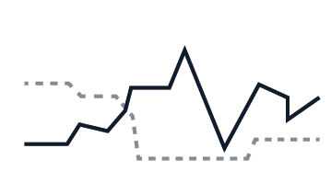

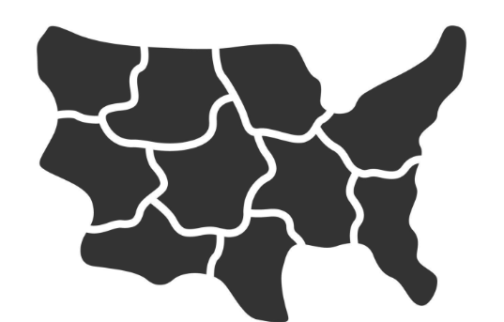


INITIAL FINDINGS
VISUALIZATIONS
Time Series Plots: Displaying the temporal patterns of forest fire occurrences and climatic variables.
Heatmaps: Showing the correlation between different climatic variables and fire incidents.
Geographical Maps: Highlighting the spatial distribution of forest fires across Peninsular Malaysia.
Box Plots: Illustrating the distribution and range of climatic variables during fire and non-fire periods.
Histograms: Depicting the frequency distribution of fire occurrences and climatic variables.

Slide 22
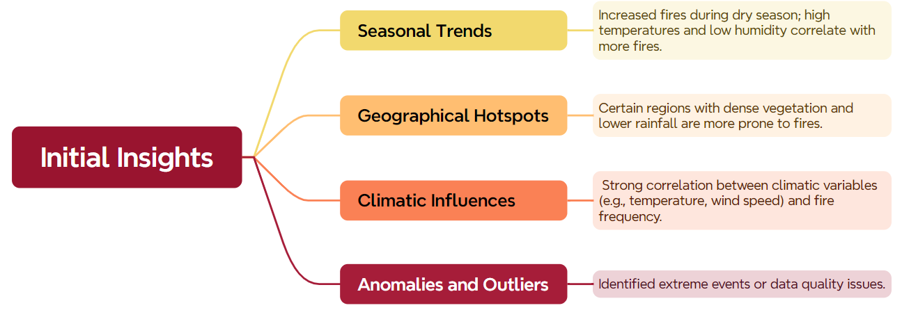
INITIAL FINDINGS
INITIAL INSIGHTS

Slide 23
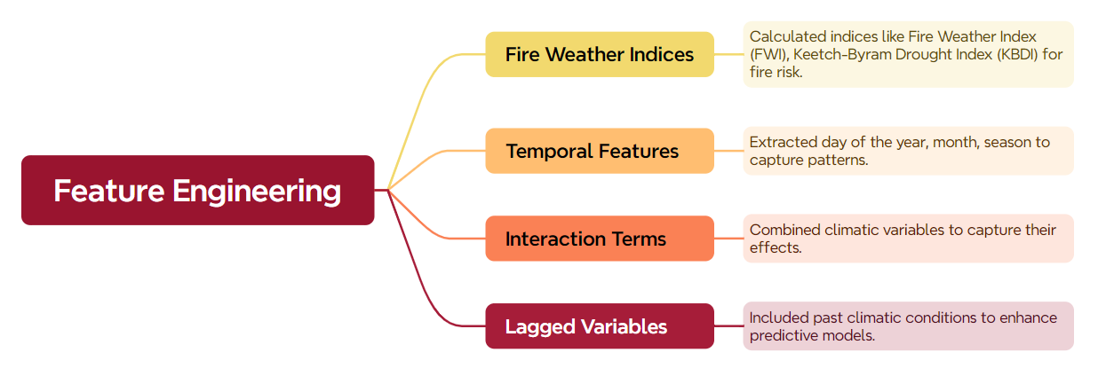
INITIAL FINDINGS
FEATURE ENGINEERING

Slide 24
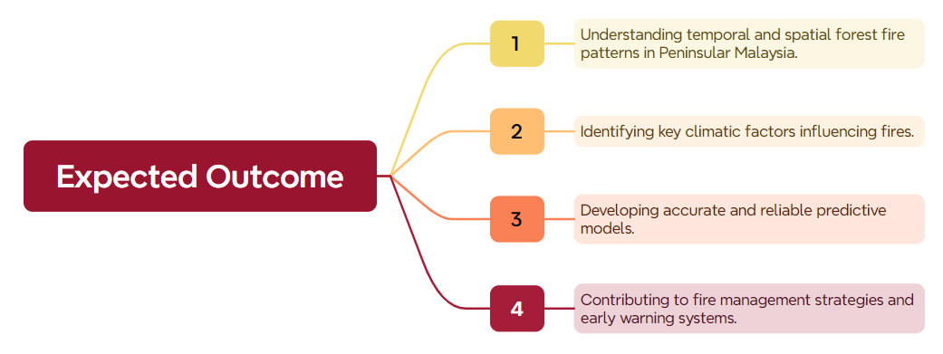
INITIAL FINDINGS
EXPECTED OUTCOME

Slide 25
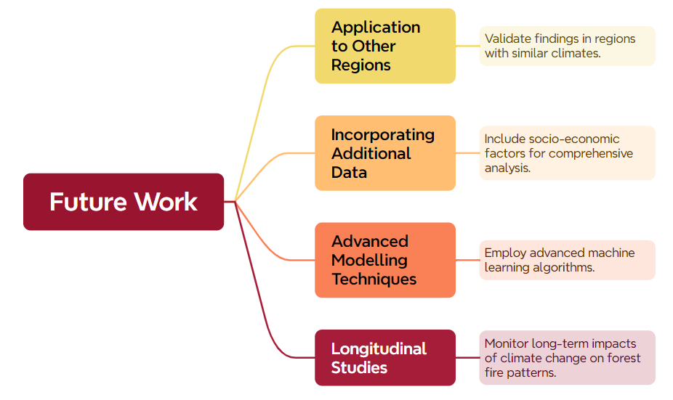
INITIAL FINDINGS
FUTURE WORK

Slide 26


